Slide 1
IPC and Standards
Combination

Slide 2
CLI Part 1 Solution

Slide 3
TODO
Finishing IPC + use cases + hands on * Protocols
Case studies
Getting a feel for the environment
Things you can interact with
where to find big sections:
1-2 services / whatevers from each section
systemctl (systemd) - create services
ssh
Next: Networking Next next: Networking API’s

Slide 4
Review: Interprocess Communication and Protocols
How processes to interact with each other
Files
Pipes
Signals
Sockets
Shared Memory
Wiki: https://en.wikipedia.org/wiki/Inter-process_communication
Notes:
Implemented as system calls since this relies on the operating system
We will look at how to use these mechanisms in the coding section. I want you all to really internalize this. For now I want you to imagine this as message passing. Since its essentially data transfer.
Most important concept next to processes and system calls. The patterns and abstractions you have access to now are unrivaled. We will touch on some of those later

Slide 5
Files:
4 main system calls:
open, read, write, close
Example: A program that writes hello world to a file

Slide 6
Practice
cat is a program that takes as input a filename and prints the contents of it to the console.
eg. cat out.txt
> hello world
Use any of open(2), read(2), write(2) and close(2)

Slide 7
Solution
source
But what’s up with the final “write” syscall?

Slide 8
File’s in Linux
Everything Is a File
eg.
stdout, stderr, stdin
IPC
Others
Notes:
Everything is a File
Open, Close, Read, Write
All IPC is treated as a file because you can open, close, read, write, etc
File Descriptors
How the OS lets us interact with files
A number the OS gives us for each file, that we can call functions on. (Show example)
Every processes has its own File Descriptor table
File Descriptors are inherited from parent processes unless we specify otherwise.
By default has Stdin, stdout, stderr which are default file descriptors.
The relationship between a terminal and a shell is wacky, I don’t understand it, something to do with TTY and PTS
Can

Slide 9
File Descriptors
File Descriptors
Every processes has its own File Descriptor table
File Descriptors are inherited from parent processes unless we specify otherwise.
Represented as a positive integer
Stdin (0), stdout (1), stderr(2) are very common descriptors
open(2), close(2), read(2), write(2), fcntl(2), dup(2), dup2(2)

Slide 10
Question: Why did our Shell’s child processes print to the same output?
Notes:
Answer: Standard Input, output, and Error (stdin, stdout, stderr) are file descriptors, and as such are inherited by child processes unless otherwise specified

Slide 11
File Descriptor Practice
Examples
Practice: Switch stdout and stderr
Use any of dup(2), dup2(2), fcntl(2), open(2), close(2), read(2) or write(2)
Notes:
We won’t use fcntl although its nice to know about

Slide 12
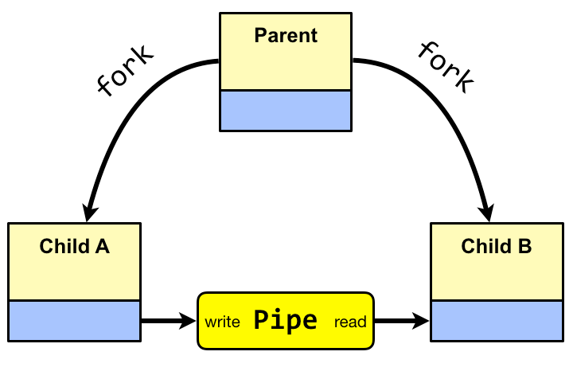
Pipes
Unidirectional communication data channel for IPC
1 write end, 1 read end
pipe(2)
Example

Slide 13
Hands on 3.2: Pipes
Pipe Yeller:
Edit the previous program, such that the previous receiving process will send back the message capitalized
Use pipe(2)
Solution
Notes:
Go over what the system would look like

Slide 14
Signals
Asynchronous “Signals” you can send to processes
There are a preset number of possible signals, all with default actions
Typically used for configuration and management of programs
Example
Syscalls: sigaction(2), raise(2) and kill(2)
Notes:
Systemd sample
Signals are typically used to instruct a daemon/service to do something such as restart, exit, reload configuration, clean cache, and more!
TODO: Send signals to existing daemons and see how they react, use systemd
Hands on using signals, inheriting signal handlers, get a feel

Slide 15
Example
Terminal
<ctrl-c> : Sends SIGINT to running process
create a process and use the kill(1) command to send it signals.
Notes:
Example using yes(1) command. Do <ctrl-c> to interrupt it.
TODO: Create code with 1 process running yes, and other to send it sigint.
Create signal handler to send message when get message.
Use Cases: Reload config files
Daemons / Services? and then systemctl

Slide 16
Signals Hands on

Slide 17
Systemd
systemctl list-units

Slide 18
Service Frontends
ssh and sshd

Slide 19
Every program is designed with an Interface

Slide 20
Homework: Read Internet Whitepaper
Notes:
Go over basic concept

Slide 21
Resources
Files: open(2), close(2), read(2), write(2), dup(2), dup2(2), fcntl(2), lseek(2)
Signal: sigaction(2), kill(1)
Pipe: pipe(2), pipe(7), popen(2)
Socket: socket(2), bind(2), connect(2), listen(2), nc(1)
Shared Memory: shmget(2), mmap(2), clone(2)
Notes:
After each item, brainstorm things you can do with it.
Signal: Very simple communication - there are a number of known signals you can send
Pipe: Unidirectional data transmission (bytestream)
Socket:

